Slide 1
SFIA Project 2
Amogh Naik

Slide 2
Contents
Introduction
My Journey through QA
Planning
Use Cases & User Stories
Risk Assessment
Back end architecture
Front end architecture (demo)
Testing
CI Pipeline & Deployment
Project Changes
Conclusion

Slide 3
Introduction
Aims of the project:
To create a service-oriented web application using Python Flask.
To plan the project using a Kanban board, making note of user stories, use cases and potential risks.
To test the application using pytest and analyse test coverage.
To deploy the application through a CI pipeline using Github, Jenkins, Docker Swarm and Ansible.
To provide thorough documentation for all of the above, including a user guide for launching the application.
How did I achieve these aims?

Slide 4
My Journey through QA
Week 1 - Project management, Documentation
Week 2 - SQL databases, GCP
Week 3 - Python coding and testing
Week 4 - Jenkins, Flask
Week 5 - Flask, Testing, Deployment
Week 6 - Linux, Service-oriented applications
Week 7 - Docker, Docker compose
Week 8 - Docker swarm, Ansible

Slide 5
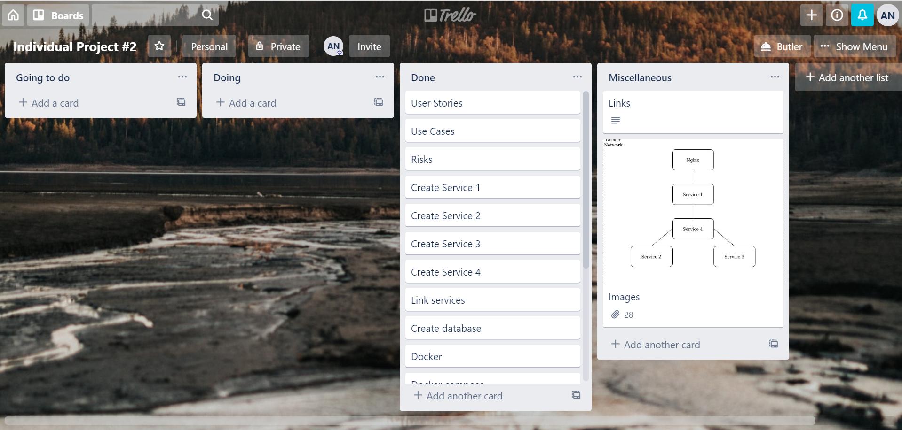
Planning

Slide 6
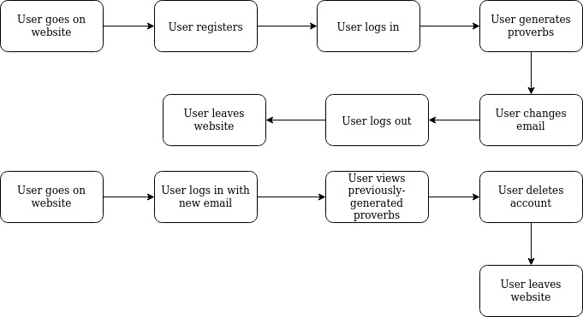
Use Cases & User Stories

Slide 7
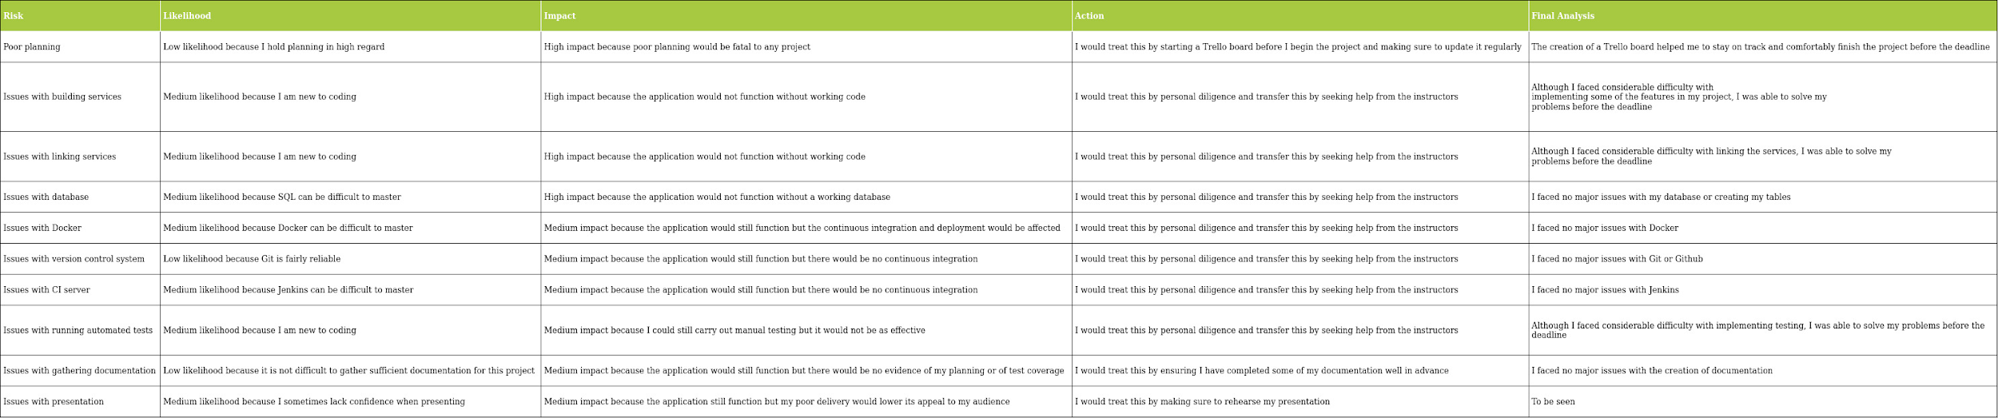
Risk Assessment

Slide 8
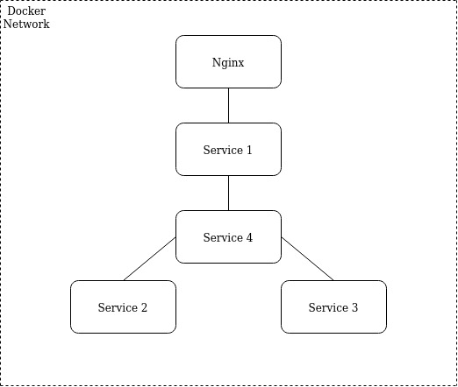
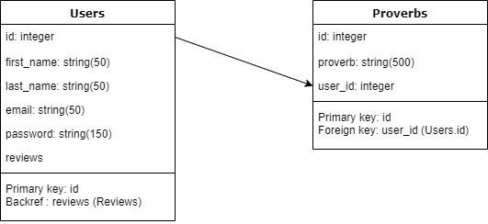
Back end architecture

Slide 9
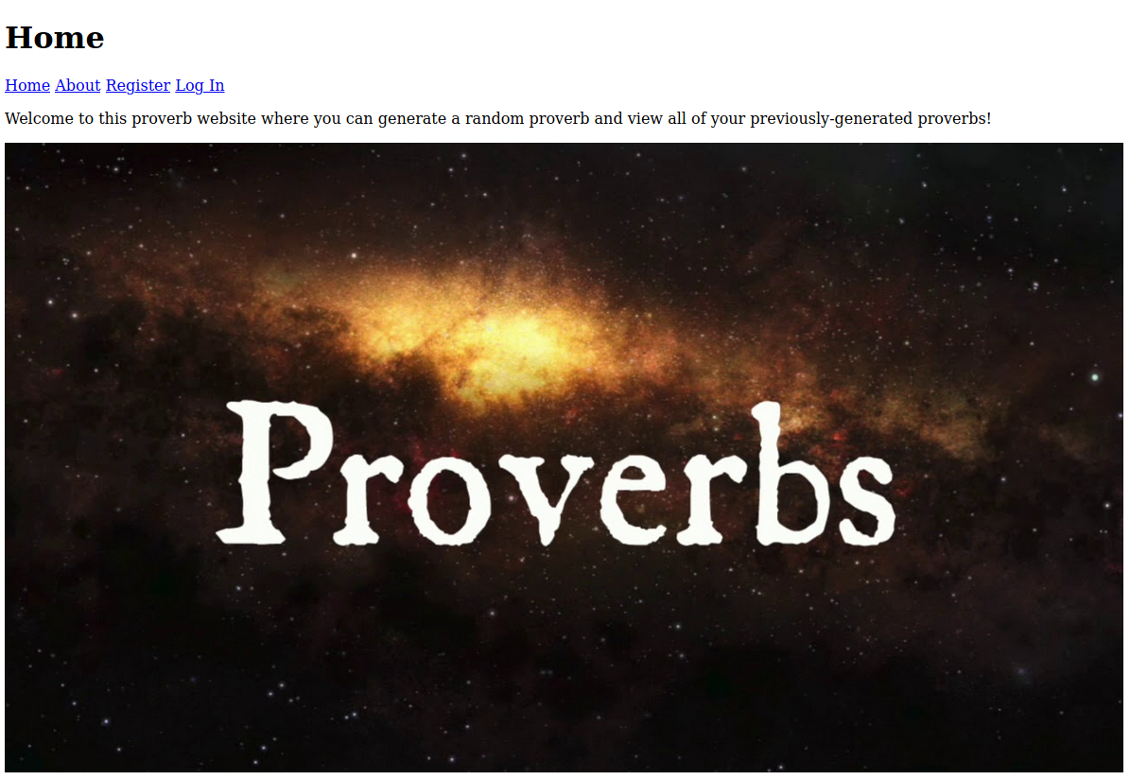
Front end architecture
Demo!
104.199.85.216

Slide 10
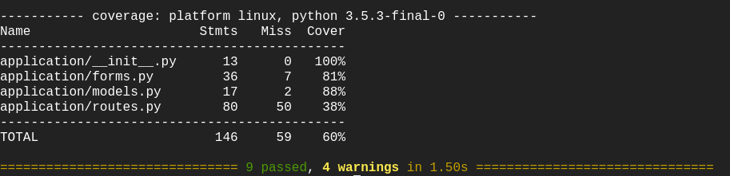
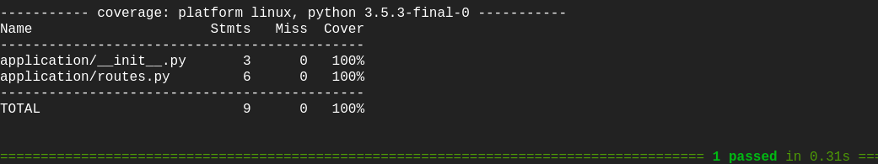
Testing

Slide 11
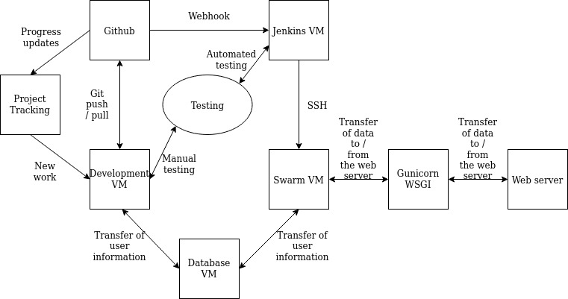
CI Pipeline & Deployment

Slide 12
Project Changes
In my initial plan, I was planning to have only four containers. However, I decided to add an nginx container which acts as a proxy pass, thus making it harder to access the back end services.
In the future, I would include:
Bootstrap to improve the design of the website.
Integration testing to improve test coverage for service 1 and so that I can test service 4.
An SQL container in Docker rather than a separate SQL instance.

Slide 13
Conclusion
Created a service-oriented application using Python Flask that generates a proverb based on a random number and letter.
Planned using Trello.
Tested 3 services using pytest and achieved a coverage of 60%, 100% and 100%.
Deployed using Github, Jenkins, Docker Swarm and Ansible.
View my code and documentation, including a user guide to launch the application, on my Github: https://github.com/amoghvnaik/project2repo.

